Slide 1
Unit III

Slide 2
Operating System (OS)
An operating system (OS) is a collection of software that manages computer hardware resources and provides common services for computer programs. The operating system is a vital component of the system software in a computer system. This tutorial will take you through step by step approach while learning Operating System concepts.

Slide 3
Functions of an Operating System.
Following are some of important functions of an operating System.
Memory Management
Processor Management
Device Management
File Management
Security
Control over system performance
Job accounting
Error detecting aids
Coordination between other software and users

Slide 4
Applications of Operating System
Following are some of the important activities that an Operating System performs −
Security − By means of password and similar other techniques, it prevents unauthorized access to programs and data.
Control over system performance − Recording delays between request for a service and response from the system.

Slide 5
Continue..
Job accounting − Keeping track of time and resources used by various jobs and users.
Error detecting aids − Production of dumps, traces, error messages, and other debugging and error detecting aids.
Coordination between other softwares and users − Coordination and assignment of compilers, interpreters, assemblers and other software to the various users of the computer systems.

Slide 6
Memory Management
Memory management refers to management of Primary Memory or Main Memory. Main memory is a large array of words or bytes where each word or byte has its own address.
Main memory provides a fast storage that can be accessed directly by the CPU. For a program to be executed, it must in the main memory. An Operating System does the following activities for memory management −

Slide 7
Continue..
Keeps tracks of primary memory, i.e., what part of it are in use by whom, what part are not in use.
In multiprogramming, the OS decides which process will get memory when and how much.
Allocates the memory when a process requests it to do so.
De-allocates the memory when a process no longer needs it or has been terminated.

Slide 8
Processor Management
In multiprogramming environment, the OS decides which process gets the processor when and for how much time. This function is called process scheduling. An Operating System does the following activities for processor management −
Keeps tracks of processor and status of process. The program responsible for this task is known as traffic controller.
Allocates the processor (CPU) to a process.
De-allocates processor when a process is no longer required.

Slide 9
Device Management
An Operating System manages device communication via their respective drivers. It does the following activities for device management −
Keeps tracks of all devices. Program responsible for this task is known as the I/O controller.
Decides which process gets the device when and for how much time.
Allocates the device in the efficient way.
De-allocates devices.

Slide 10
File Management
A file system is normally organized into directories for easy navigation and usage. These directories may contain files and other directions.
An Operating System does the following activities for file management −
Keeps track of information, location, uses, status etc. The collective facilities are often known as file system.
Decides who gets the resources.
Allocates the resources.
De-allocates the resources.

Slide 11
Other Important Activities
Security − By means of password and similar other techniques, it prevents unauthorized access to programs and data.
Control over system performance − Recording delays between request for a service and response from the system.
Job accounting − Keeping track of time and resources used by various jobs and users.
Error detecting aids − Production of dumps, traces, error messages, and other debugging and error detecting aids.
Coordination between other softwares and users − Coordination and assignment of compilers, interpreters, assemblers and other software to the various users of the computer systems.

Slide 12
Purpose of Operating System:
OS as a platform for Application programs:
Operating system provides a platform, on top of which, other programs, called application programs can run. These application programs help the users to perform a specific task easily. It acts as an interface between the computer and the user. It is designed in such a manner that it operates, controls, and executes various applications on the computer.

Slide 13
Continue..
Managing Input-Output unit:
Operating System also allows the computer to manage its own resources such as memory, monitor, keyboard, printer, etc. Management of these resources is required for effective utilization. The operating system controls the various system input-output resources and allocates them to the users or programs as per their requirement.

Slide 14
Continue..
Consistent user interface:
Operating System provides the user an easy-to-work user interface, so the user doesn’t have to learn a different UI every time and can focus on the content and be productive as quickly as possible. Operating System provides templates, UI components to make the working of a computer, really easy for the user.

Slide 15
Continue..
Multitasking:
Operating System manages memory and allows multiple programs to run in their own space and even communicate with each other through shared memory. Multitasking gives users a good experience as they can perform several tasks on a computer at a time.

Slide 16
User interface
The OS provides a user interface (UI), an environment for the user to interact with the machine. The UI is either graphical or text-based.
Graphical user interface (GUI)
The OS on most computers and smartphones provides an environment with tiles, icons and/or menus. This type of interface is called the graphical user interface (GUI) because the user interacts with images through a mouse, keyboard or touchscreen.

Slide 17
Continue..
Command line interface (CLI)
An OS also provides a method of interaction that is non-graphical, called the command line interface (CLI). This is a text-only service with feedback from the OS appearing in text. Using a CLI requires knowledge of the commands available on a particular machine.
Advantages of using the command line include:
a faster way to get tasks done
it is more flexible than a GUI
it uses less memory

Slide 18
Types of Operating System (OS)
Following are the popular types of Operating System:
Batch Operating System
Multitasking/Time Sharing OS
Multiprocessing OS
Real Time OS
Distributed OS
Network OS
Mobile OS

Slide 19
Batch Operating System
Some computer processes are very lengthy and time-consuming. To speed the same process, a job with a similar type of needs are batched together and run as a group.
The user of a batch operating system never directly interacts with the computer. In this type of OS, every user prepares his or her job on an offline device like a punch card and submit it to the computer operator.

Slide 20
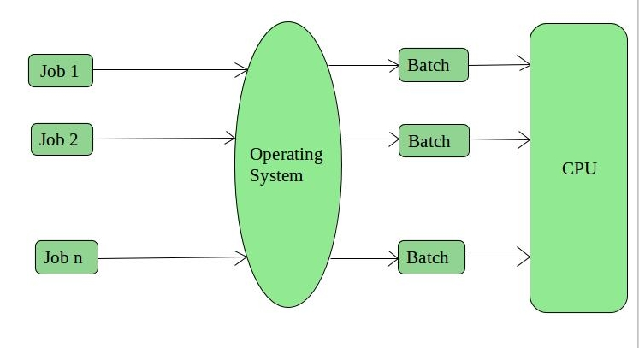
Continue..

Slide 21
Multi-Tasking/Time-sharing Operating systems
Time-sharing operating system enables people located at a different terminal(shell) to use a single computer system at the same time. The processor time (CPU) which is shared among multiple users is termed as time sharing.
Each task is given some time to execute so that all the tasks work smoothly. Each user gets the time of CPU as they use a single system. These systems are also known as Multitasking Systems. The task can be from a single user or different users also. The time that each task gets to execute is called quantum. After this time interval is over OS switches over to the next task.

Slide 22
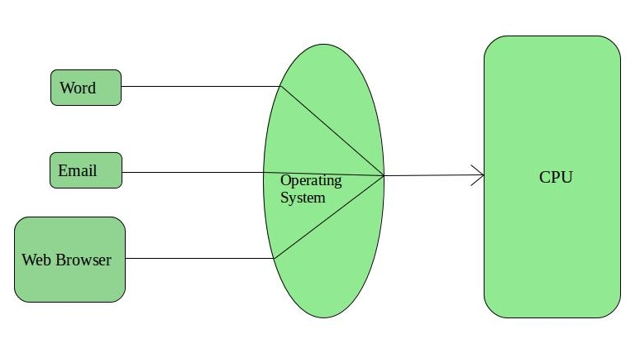
Continue..

Slide 23
Real time OS
A real time operating system time interval to process and respond to inputs is very small. Examples: Military Software Systems, Space Software Systems are the Real time OS example.
These types of OSs serve real-time systems. The time interval required to process and respond to inputs is very small. This time interval is called response time.
Real-time systems are used when there are time requirements that are very strict like missile systems, air traffic control systems, robots, etc.

Slide 24
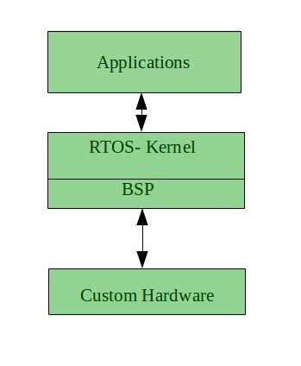
Continue..

Slide 25
Distributed Operating System
Distributed systems use many processors located in different machines to provide very fast computation to its users.
These types of the operating system is a recent advancement in the world of computer technology and are being widely accepted all over the world and, that too, with a great pace. Various autonomous interconnected computers communicate with each other using a shared communication network.

Slide 26
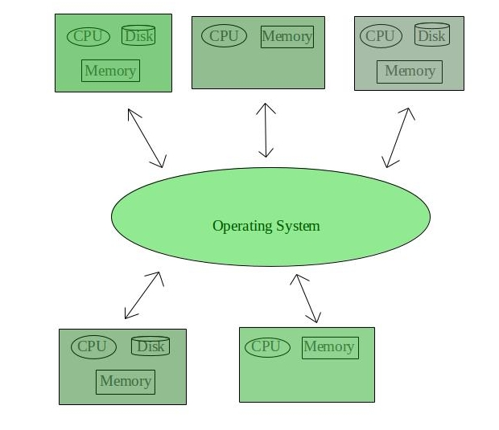
Continue..

Slide 27
Network Operating System
Network Operating System runs on a server. It provides the capability to serve to manage data, user, groups, security, application, and other networking functions.
These systems run on a server and provide the capability to manage data, users, groups, security, applications, and other networking functions. These types of operating systems allow shared access of files, printers, security, applications, and other networking functions over a small private network.

Slide 28
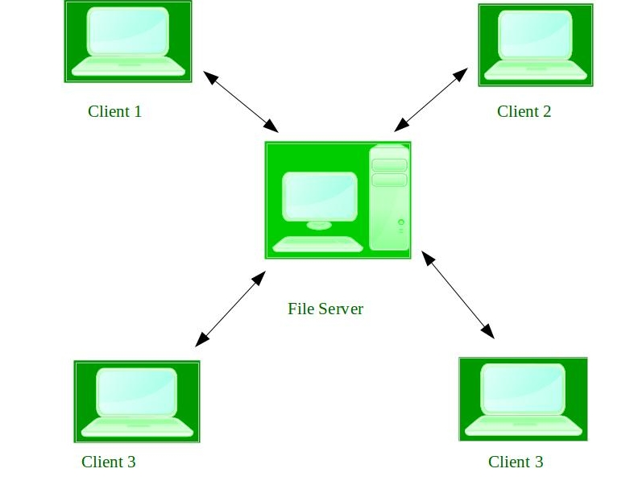
Continue..

Slide 29
Mobile OS
Mobile operating systems are those OS which is especially that are designed to power smartphones, tablets, and wearables devices.

Slide 30
Running Programs
"Software" is the general category of code which runs on the hardware. If the hardware is a player piano, then the software is the music. The common case is a "program" like Firefox -- software you run on your computer to solve a particular problem. A computer can run multiple programs at the same time and is responsible for keeping their memory separate.

Slide 31
Continue..
A CPU understands a low level "machine code" language (also known as "native code"). The language of the machine code is hardwired into the design of the CPU hardware; it is not something that can be changed at will. Each family of compatible CPUs (e.g. the very popular Intel x86 family) has its own, idiosyncratic machine code which is not compatible with the machine code of other CPU families.

Slide 32
Continue..
The machine code defines a set of individual instructions. Each machine code instruction is extremely primitive, such as adding two numbers or testing if a number is equal to zero. When stored, each instruction takes up just a few bytes. When we said earlier that a CPU can execute 2 billion operations per second, we meant that the CPU can execute 2 billion lines of machine code per second.

Slide 33
How Does a Program Run?
CPU runs a "fetch/execute cycle"
-fetch one instruction in sequence
-execute (run) that instruction, e.g. do the addition
-fetch the next instruction, and so on
Run a program = Start CPU running on its 1st instruction
it runs down through all of the machine code, running the program
the program will have instructions like "return to step 3" to keep it running
Super simple machine code instructions run at the rate of 2 billion per-second

Slide 34
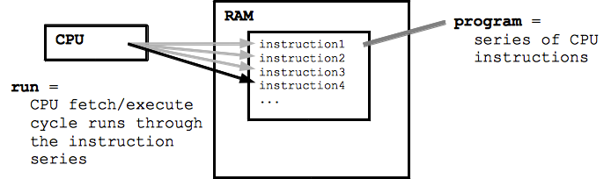
Continue..

Slide 35
How Does a Program Start?
The file Firefox.exe contains its instructions (in the file system)
To start Firefox.exe running:
-Each program gets its own area of RAM
-The RAM area holds the program's code and data it manipulates
-The instruction bytes are copied from storage to RAM
-The CPU is directed to start running at the first instruction
-Now the program is running!

Slide 36
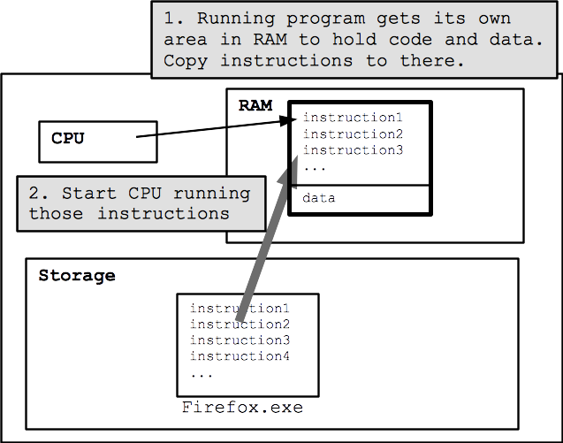
Continue..

Slide 37
Utility Software
Utility software helps to manage, maintain and control computer resources. Operating systems typically contain the necessary tools for this, but separate utility programs can provide improved functionality. Utility software is often somewhat technical and targeted at users with a solid knowledge of computers. If you use a computer mostly for e-mail, some Internet browsing and typing up a report, you may not have much need for these utilities. However, if you are an avid computer user, these utilities can help make sure your computer stays in tip-top shape.
Examples of utility programs are antivirus software, backup software and disk tools. Let's look at each of these in a bit more detail.

Slide 38
Continue..
Antivirus software, as the name suggests, helps to protect a computer system from viruses and other harmful programs. A computer virus is a computer program that can cause damage to a computer's software, hardware or data. It is referred to as a virus because it has the capability to replicate itself and hide inside other computer files.
One of the most common ways to get a virus is to download a file from the Internet. Antivirus software scans your online activity to make sure you are not downloading infected files. New viruses are coming out all the time, so antivirus software needs to be updated very frequently.

Slide 39
Continue..
Backup software helps in the creation of a backup of the files on your computer. Most computer systems use a hard disk drive for storage. While these are generally very robust, they can fail or crash, resulting in costly data loss. Backup software helps you copy the most important files to another storage device, such as an external hard disk. You can also make an exact copy of your hard disk.
Increasingly, backup software uses cloud storage to create backups. This typically means you pay a fee to use the storage space of a third party and use their backup software to manage which files are going to be backed up.

Slide 40
Continue..
Disk tools include a range of different tools to manage hard disk drives and other storage devices. This includes utilities to scan the hard disks for any potential problems, disk cleaners to remove any unnecessary files, and disk defragmenters to re-organize file fragments on a hard disk drive to increase performance. Disk tools are important because a failure of a hard disk drive can have disastrous consequences. Keeping disks running efficiently is an important part of overall computer maintenance.

